Slide 1
Project Title: TRAVELER ASSISTANT UNIVERSITY OF MANAGEMENT AND TECHNOLOGY

Slide 2
Advisor : Dr, Amjad H.Zahid Group Member: Aleena Aftab F2019065227 EHSAN Ali F2019065021

Slide 3
A travel management system helps to travel managers book, track, and analyze business travels .A typically, it refers to the platform of management that offers travel inventory ,travel policies and reporting. But it can also refer to the overall process of managing corporate travel.
INTRODUCTION :

Slide 4
SCOPE: Following are the scope of the travel management : Travel Agencies Government Tourism Department Tour Operations Immigrations and customers services Hotels

Slide 5
TOOLS 1) HTML 2) CSS 3) JAVASCRIPT 4) PHP

Slide 6
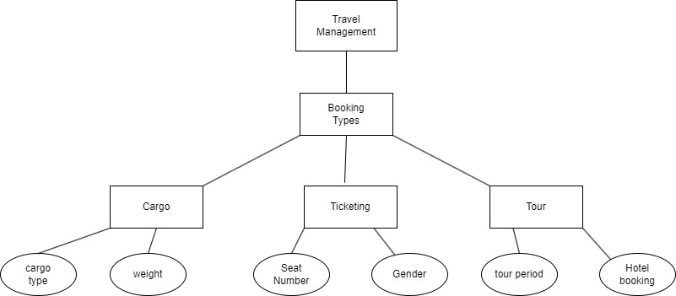
Working Flow of Traveler Assistant

Slide 7
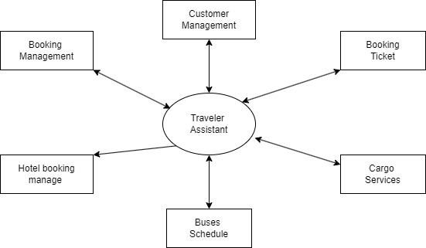
Diagram Of Travel Assistant

Slide 8


